Slide 1
HCI - Assignment n.2
Design and prototyping of an application using a human-centered approach
Deliverable n. 1: Requirement Analysis
Brainwave Academy
Group: André Oliveira, 107637
Hugo Correia, 108215
Joaquim Rosa, 109089
Lab Class: P1

Slide 2
Introduction Brainwave Academy
Motivation:
Focus on students
Support for students with difficulties
Encouragement for knowledge-seeking students
Online learning
Assistance for all taught subjects
Easy and convenient access
Personal interests:
Continuously providing beneficial learning material
Digital resources, dematerialization of content
Ability to choose the content you want to focus on
Having a variety of materials for the same topic
Why this project?
Throughout our academic journey, we would have liked to have had more reliable study supports in the search for better academic performance, and this idea defends that same purpose.

Slide 3
Project Objectives Brainwave Academy
High-level goals:
Help students achieve academic success
Generate sustainable revenue for teachers
Expected outcomes:
Make available as easy-to-use calendar for planning activities, tasks and important events
Select qualified teachers and experts to create and publish teaching vídeos
Offer paid subscriptions to access vídeos from teachers
Provide resources and tools to assist students in learning and development
Benefits:
Assist students in learning
Study organization
School life organization
Extra income for teachers

Slide 4
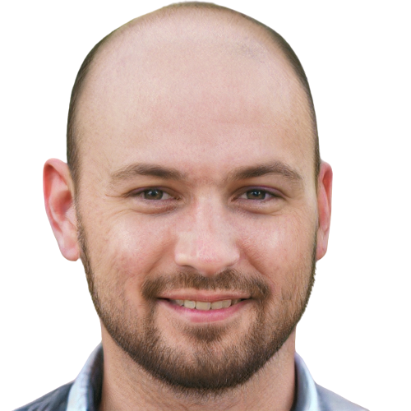
Personas - Teacher Brainwave Academy
Name: Pedro Alvalade
Gender: Male
Age: 40
Profession: High School Mathematics Teacher
Background: Pedro has a degree in Mathematics and has been working as a teacher for over 15 years
Main motivations and goals: To share his knowledge with those in need and earn some income while doing so
Needs: An easy-to-use platform to post his videos, access to tools for analyzing student performance, and technical support

Slide 5

Personas - Student Brainwave Academy
Name: Matilde Sousa
Gender: Female
Age: 17
Profession: High School Student
Background: Matilde is a dedicated and hardworking student but struggles with Mathematics. They come from a school with limited resources
Main motivations and goals: Matilde wants to achieve higher grades to apply for university. They also want to do it in a flexible way
Needs: Easy access to high-quality educational videos in Mathematics

Slide 6
Scenarios – Teacher Brainwave Academy
Pedro is an experienced math teacher who enjoys helping struggling students and needs to scrape together some extra cash
He discovers the existence of the project platform that has content uploaded by other teachers
Pedro then decides to register as a teacher on the website, proving that he has professional training
Pedro records and edits a
video course with some contents of high school mathematics
He uploads the course to his content area on the project platform and assigns a monthly fee to his content package
Pedro answers questions posed by students in the comments sections of his videos

Slide 7
Scenarios – Student(1) Brainwave Academy
Matilde is in 12th grade and needs to get a good grade in the Math A National Exam
She is having some doubts in Trigon Functions topic
While looking for supplementary study material she ends up finding the project's platform
Matilde registers on the platform as a student
She searches for a course with explanations of Trigon Functions topic
When she finds what she wants, Matilde subscribes to get access to the course

Slide 8
Scenarios – Student(2) Brainwave Academy
Matilde wants to organize his school life
She logs into his personal area, on the platform
Matilde notes the dates of her tests

Slide 9
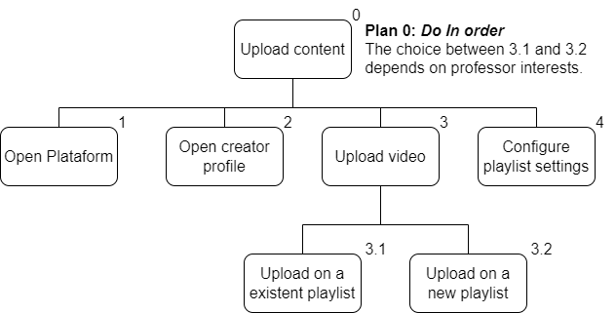
Tasks – Teacher Brainwave Academy
course
course
course

Slide 10
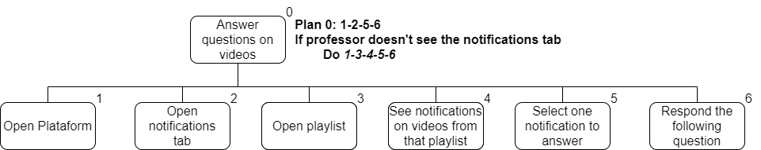
Tasks – Teacher Brainwave Academy
course
course

Slide 11
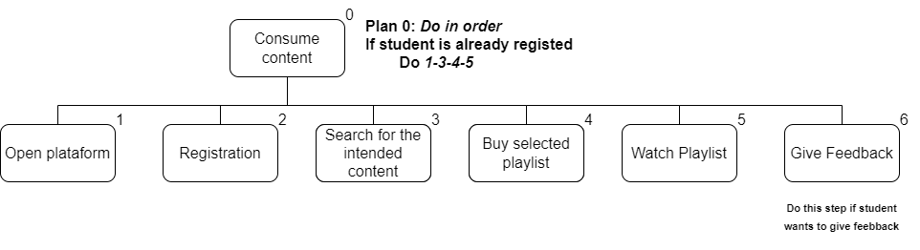
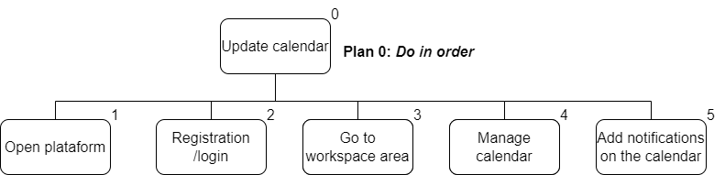
Tasks – Student Brainwave Academy
course
course

Slide 12
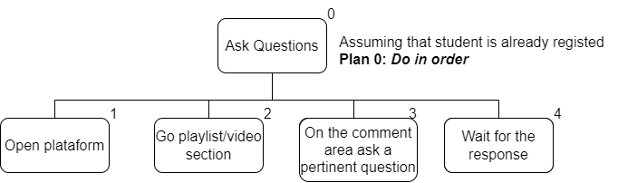
Tasks – Student Brainwave Academy
course/vídeo

Slide 13
Non-functional requirements Brainwave Academy
Realiabiblity
Performance
Security
The platform should be reliable and available to users most of time
The platform should be fast and responsive, ensuring a pleasant user experience
The platform should protect users' personal information and ensure the security of data stored on the platform
Usability
Compatibility
The platform should be easy to use and intuitive, with a clear and organized user interface
The platform should be compatible with different devices and web browsers

Slide 14
Function requirements Brainwave Academy
Registration
Calendar
Content Management
Allow users to register on the platform and create an account with personal information
Provide a calendar for students to organize their schedules and school activities
Allow teachers to publish educational videos and other relevant materials on the platform
Personal Space
Evaluation System
Provide a personal space for students to input their grades and track their progress
Allow students to evaluate educational content and provide feedback to teachers

Slide 15
02
Low Fidelity Prototype (LFP) and User Evaluation Brainwave Academy

Slide 16
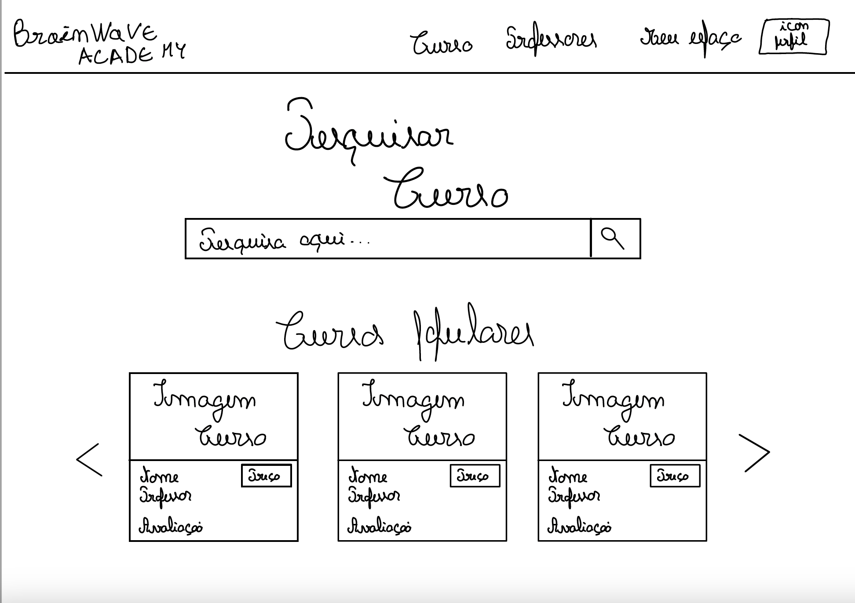
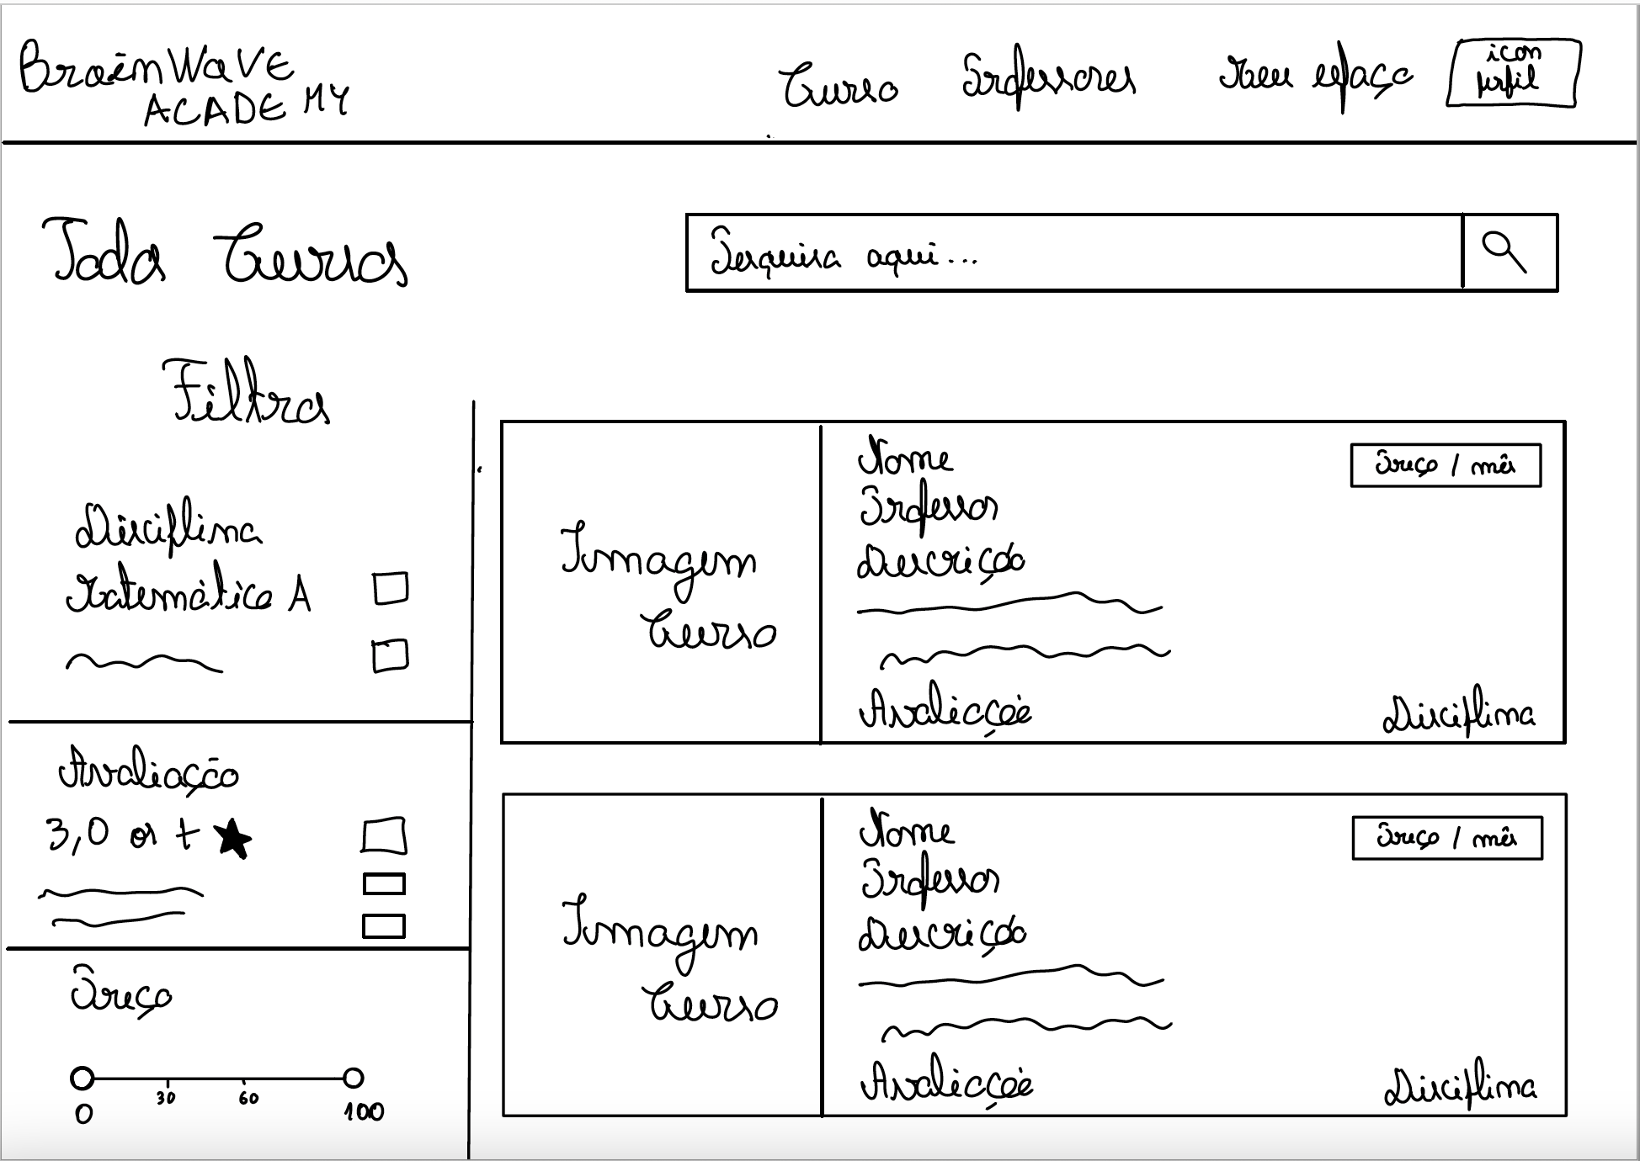
Low Fidelity Prototype (LFP) Brainwave Academy

Slide 17
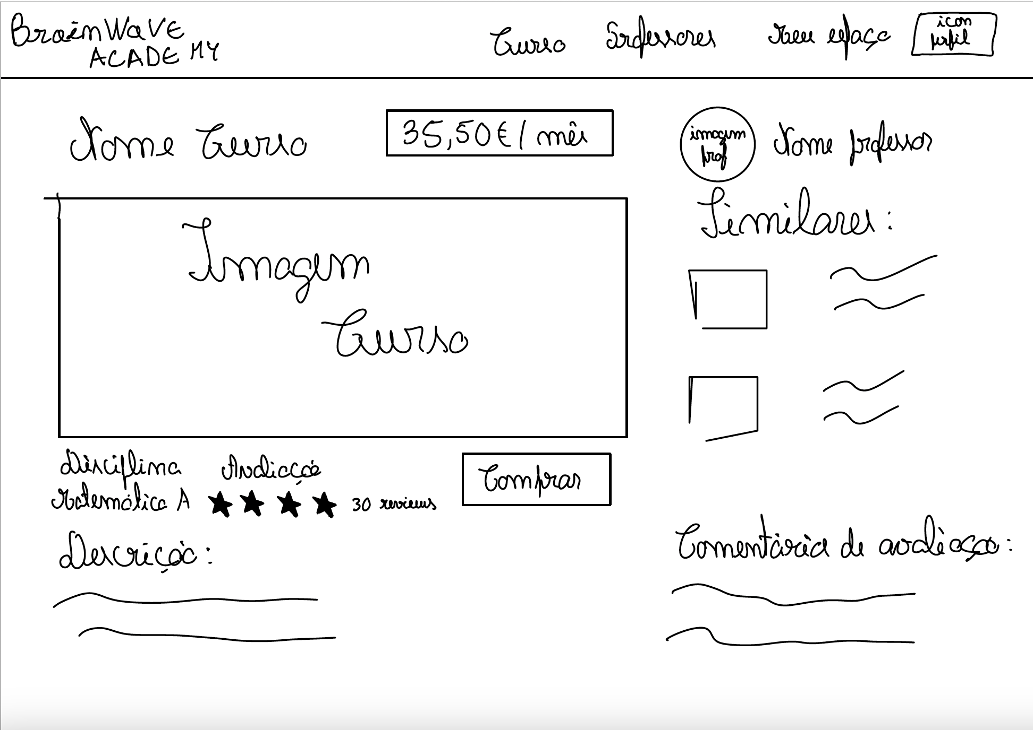
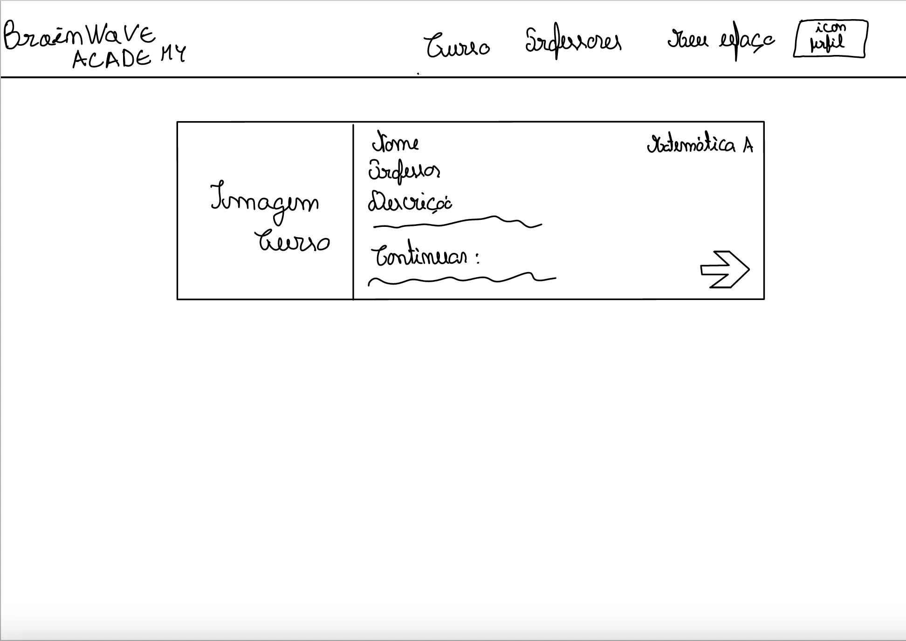
Low Fidelity Prototype (LFP) Brainwave Academy

Slide 18
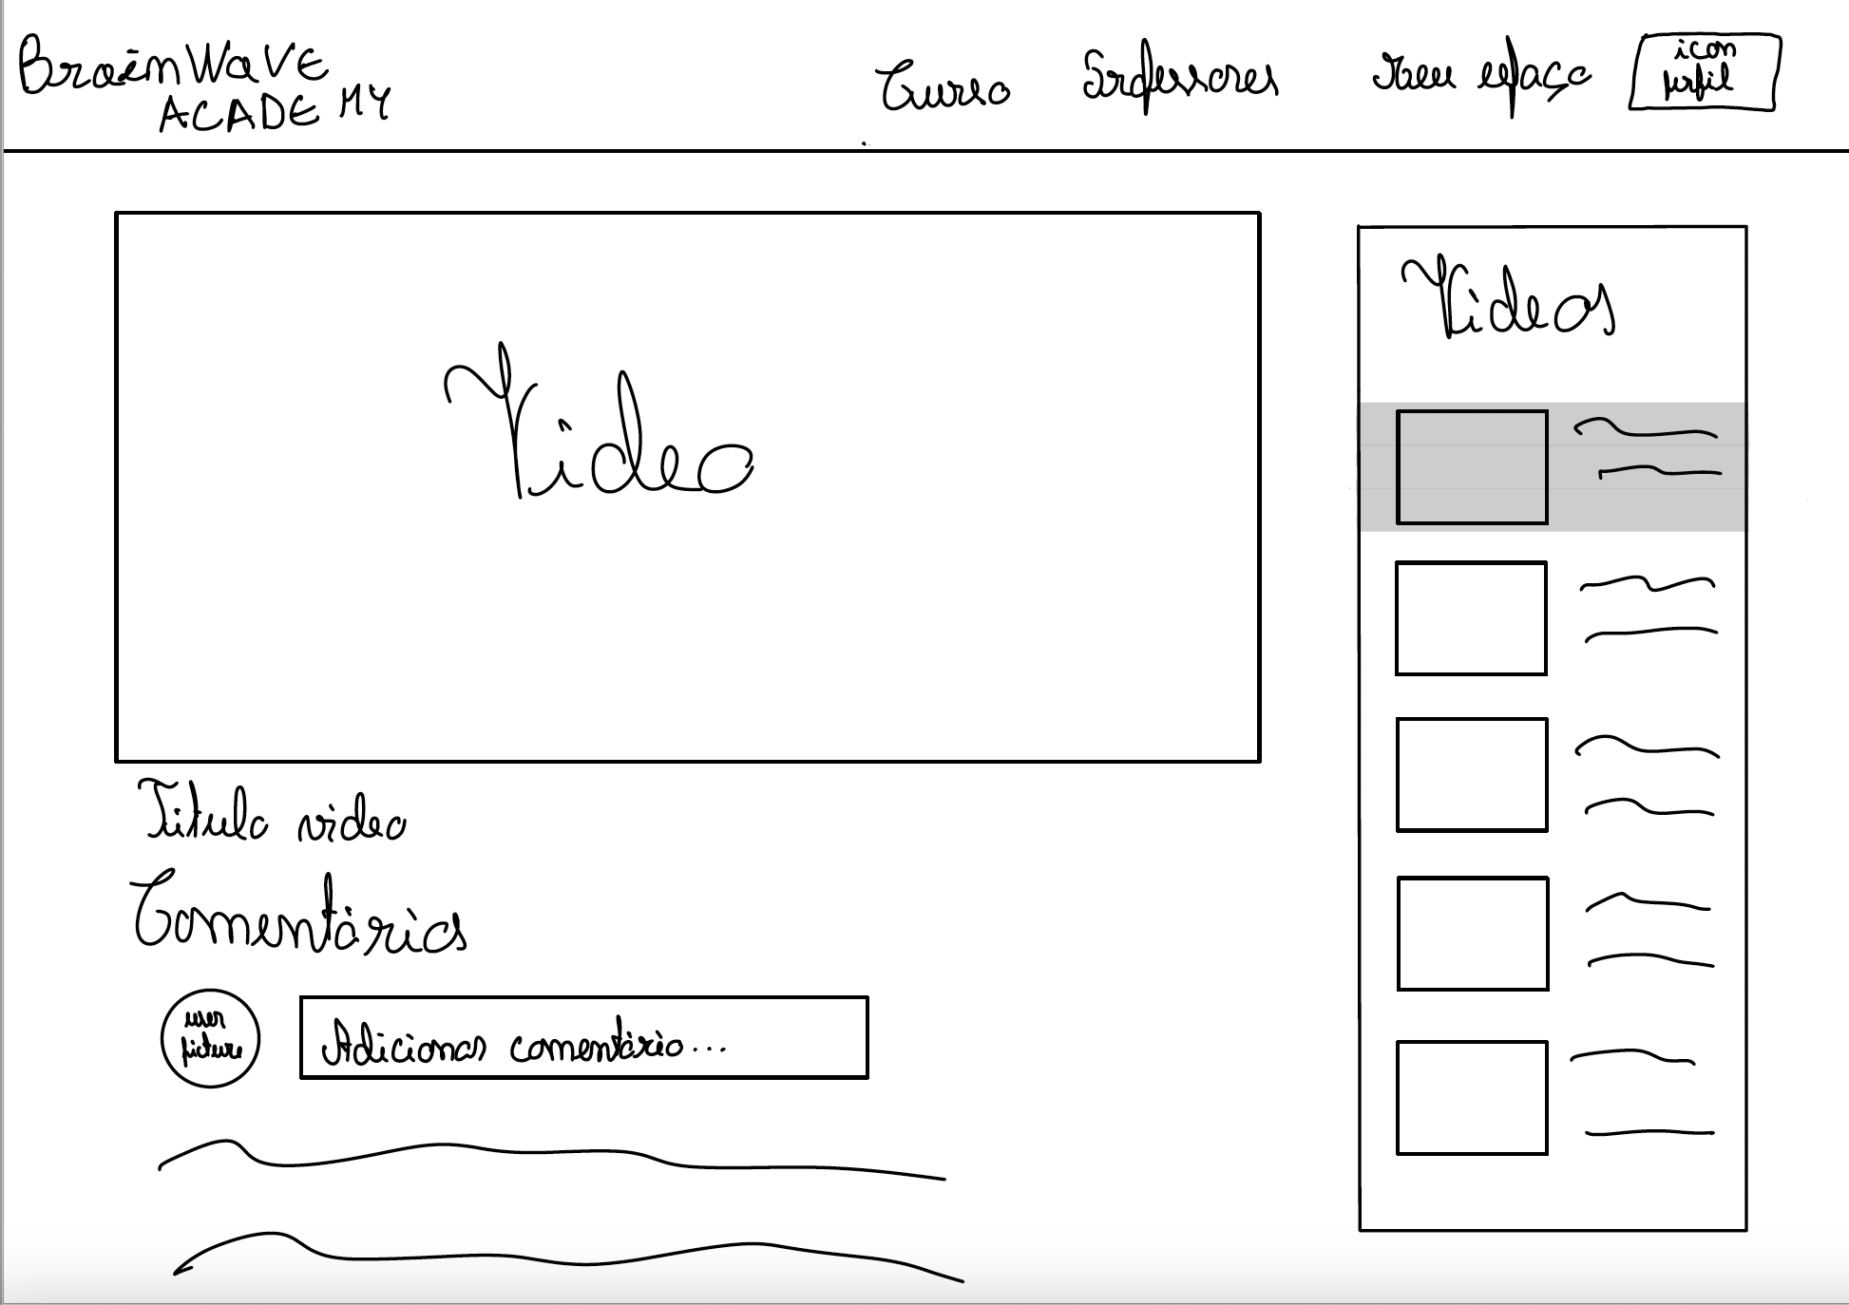
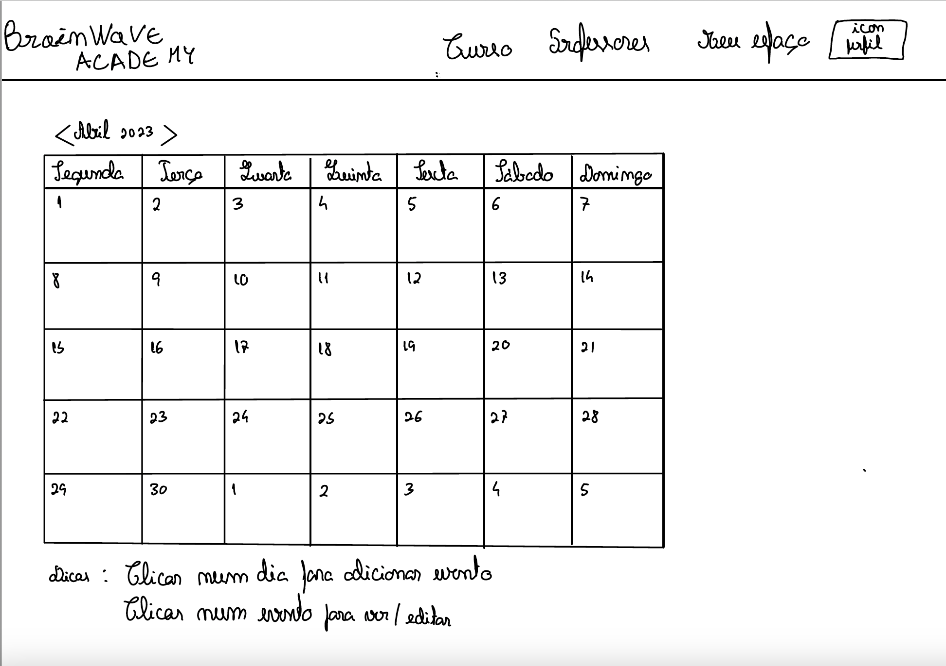
Low Fidelity Prototype (LFP) Brainwave Academy

Slide 19
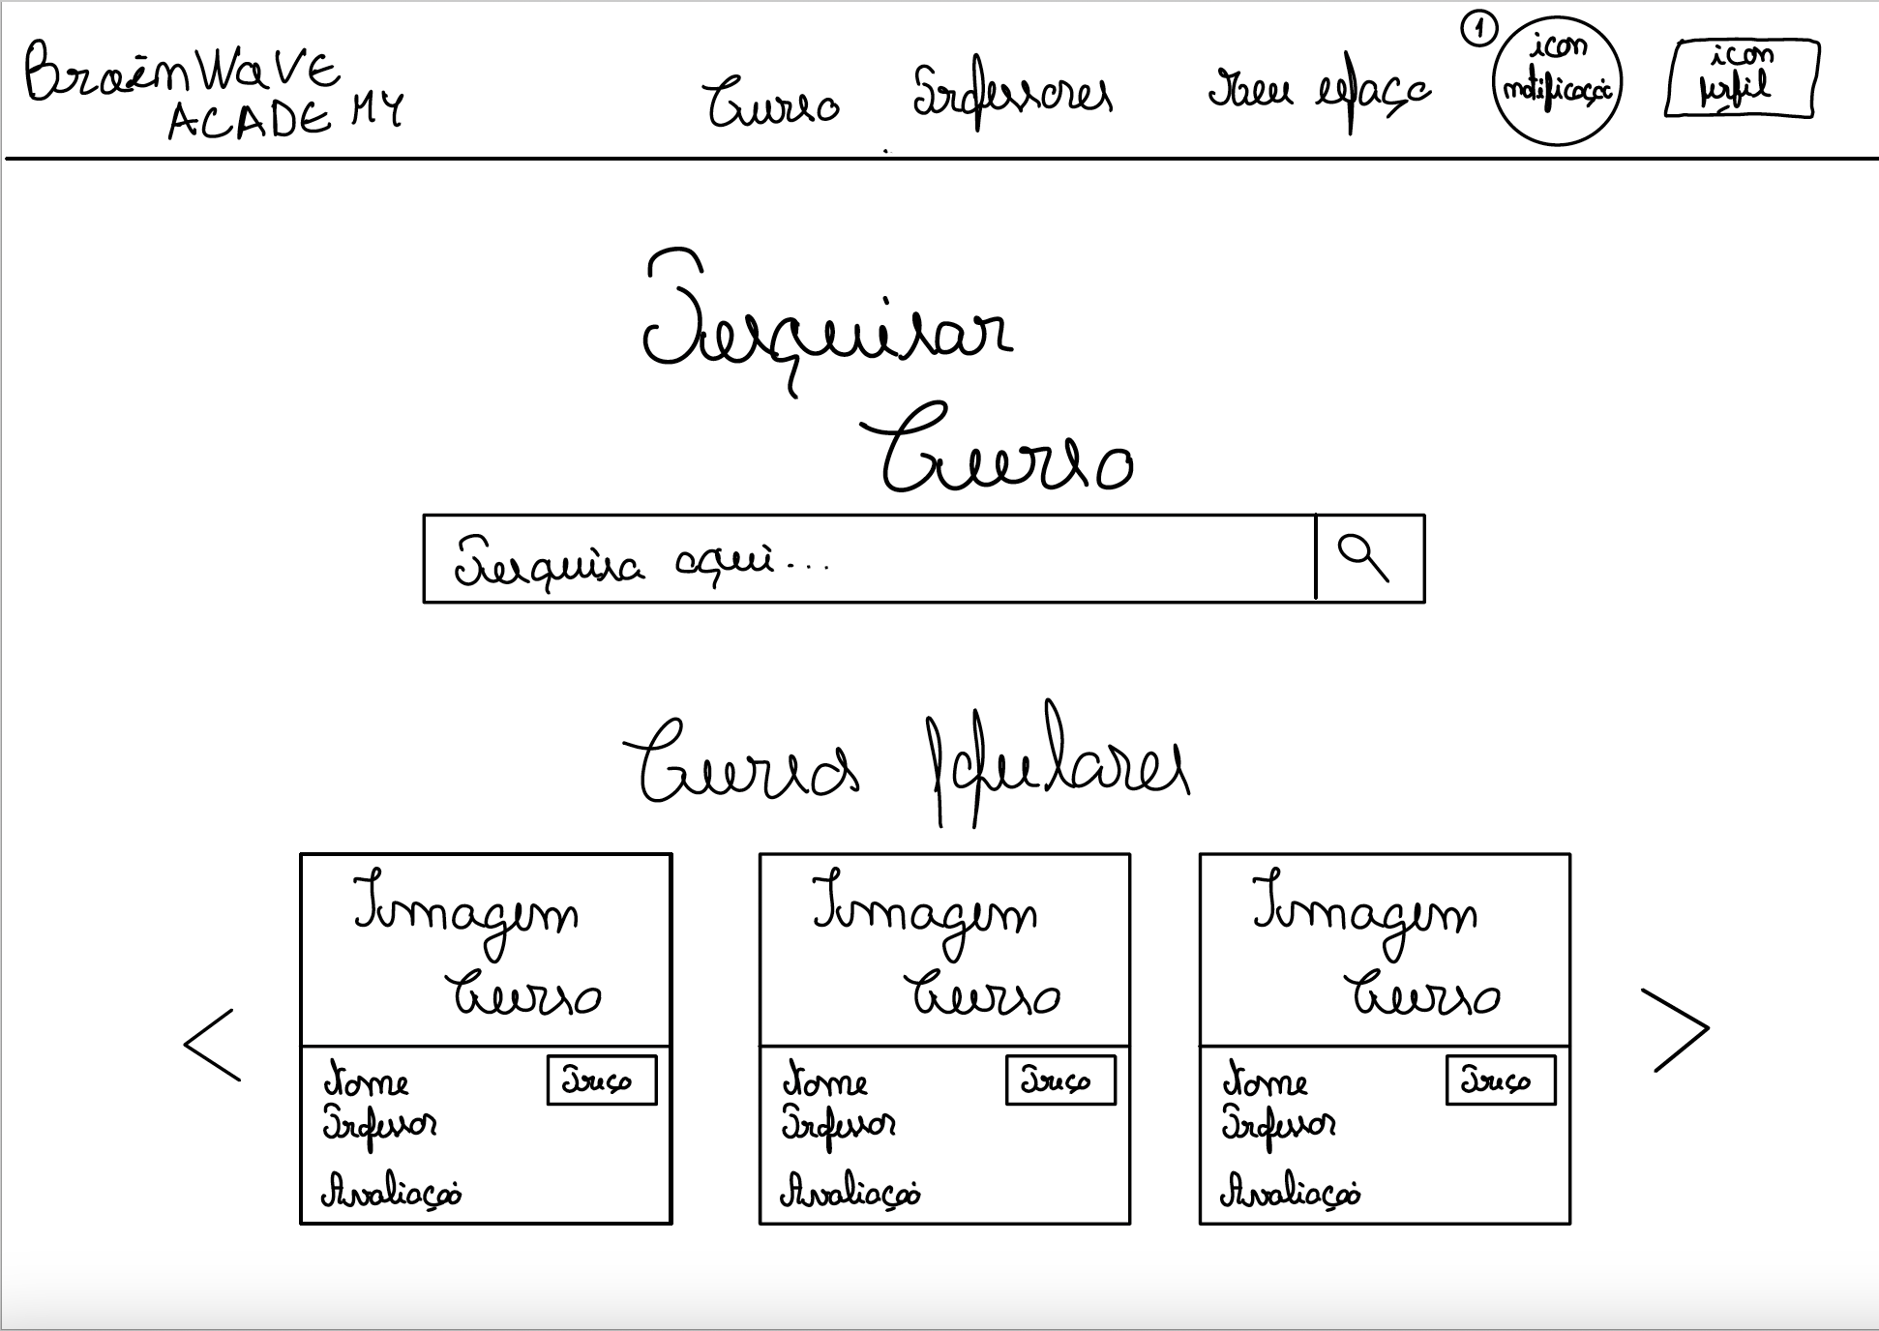
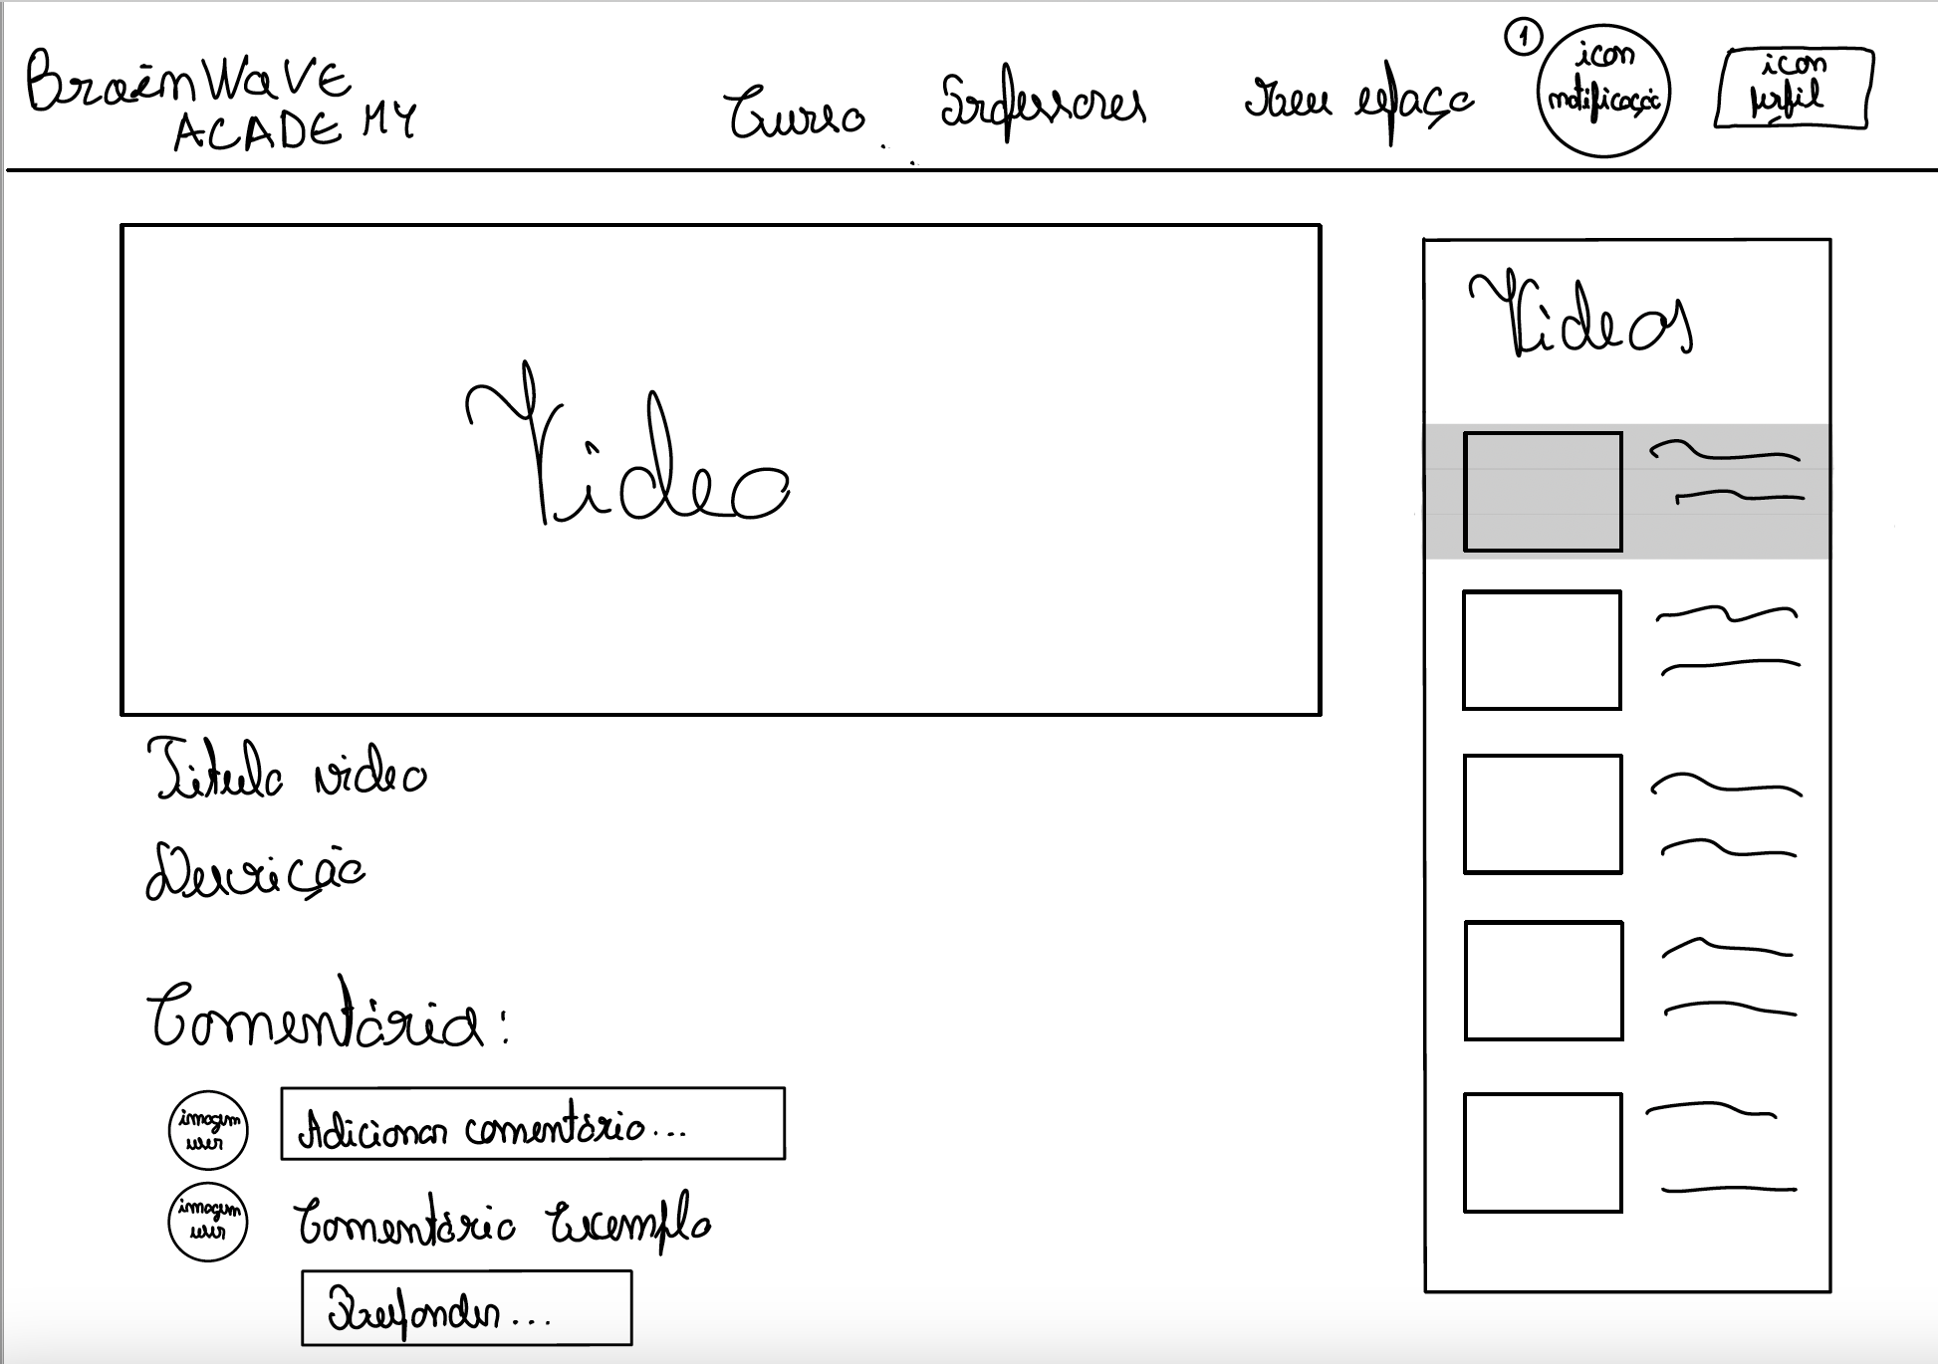
Low Fidelity Prototype (LFP) Brainwave Academy

Slide 20
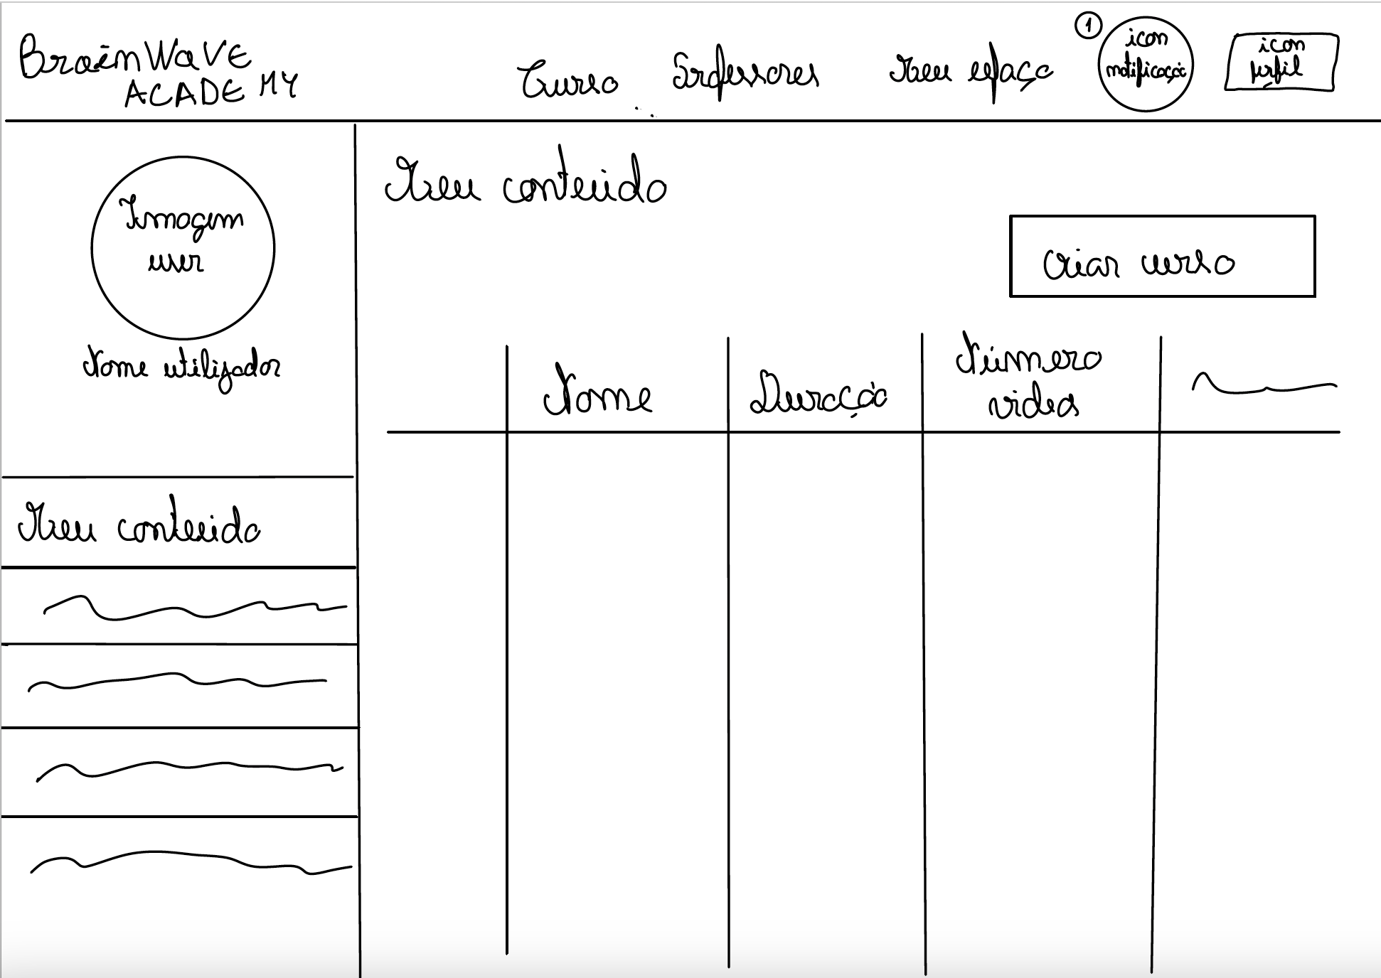
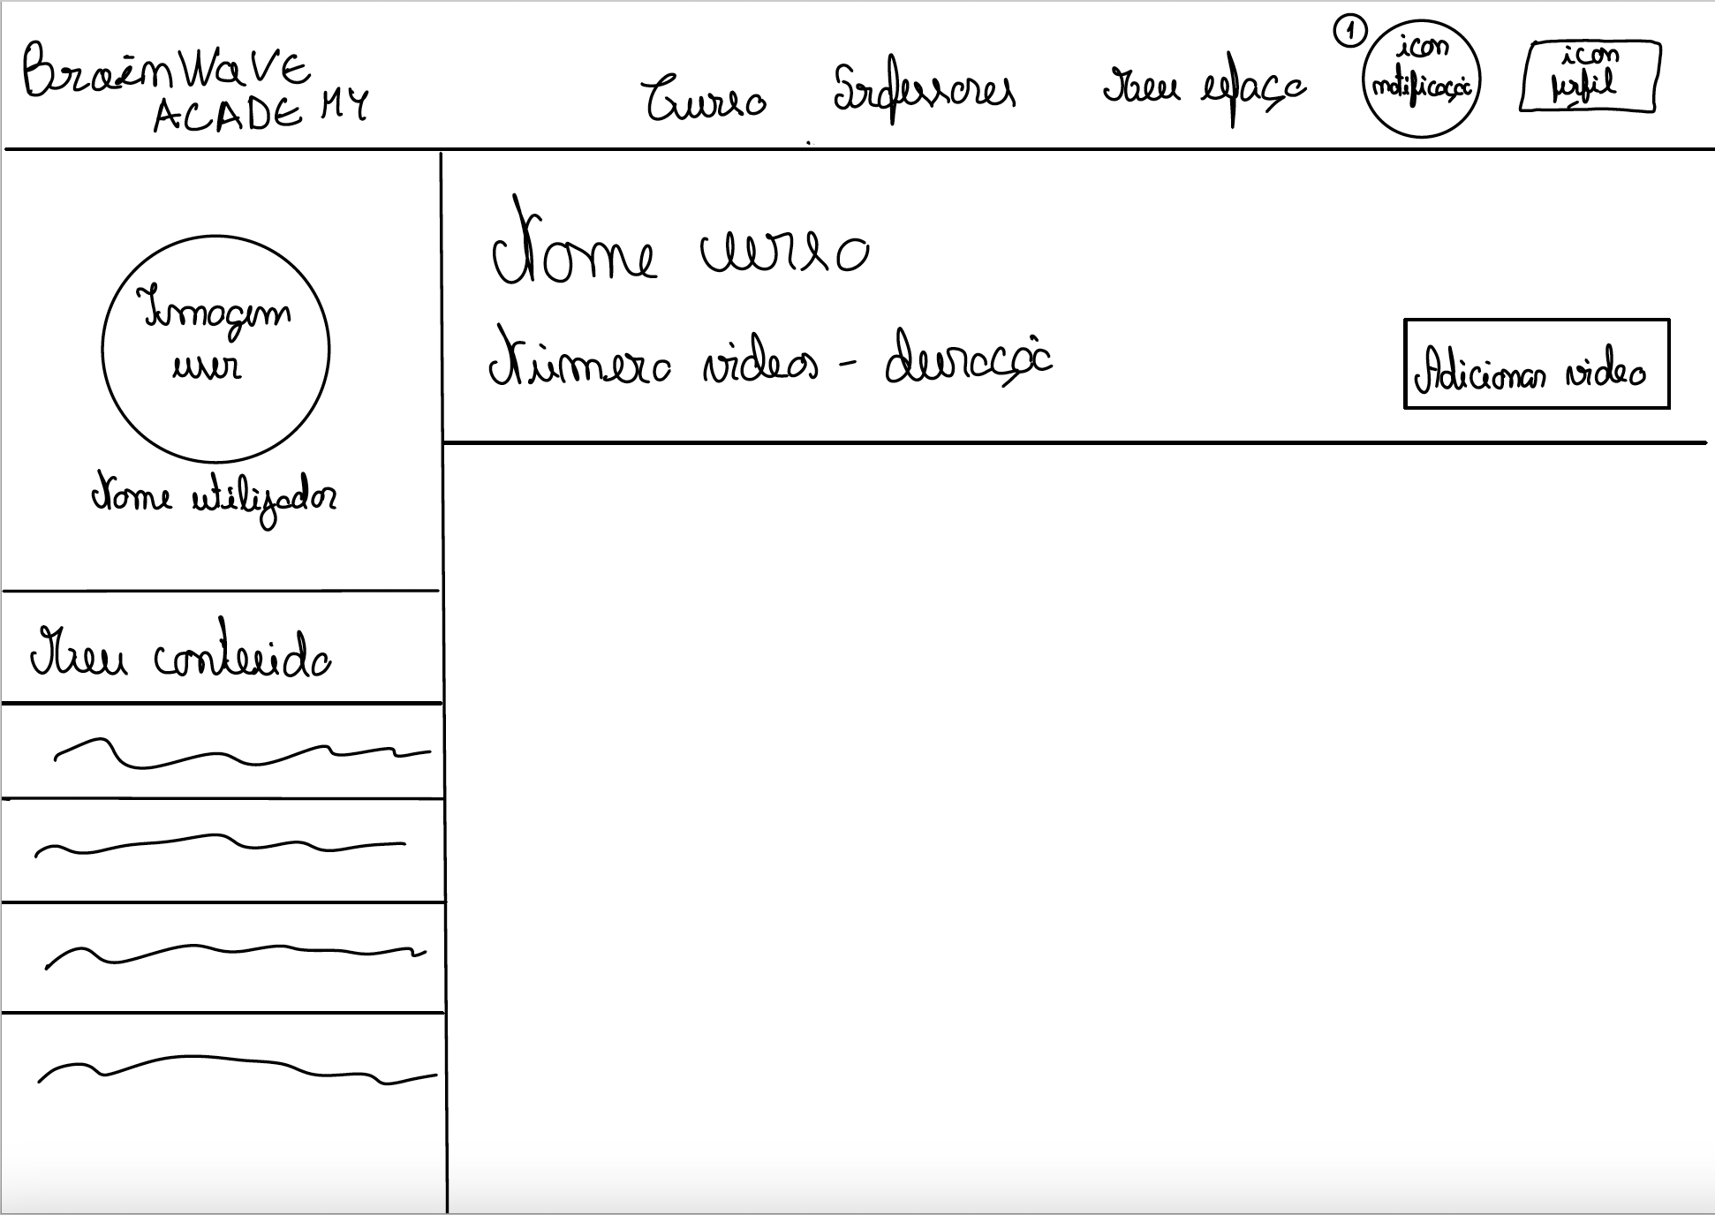
Low Fidelity Prototype (LFP) Brainwave Academy

Slide 21
LFP User Evaluation: Tasks Brainwave Academy
Student:
Task 1: Using the filters, find a math course up to 100 euros and choose the cheapest one, buying with a credit card. Go to the course and start watching the first video.
Task 2: Go to your calendar and add a math study assignment.
Professor:
Task 3: Through the notifications icon, respond to a comment from a student.
Task 4: Create a course called "Matemática A" and add a video in it called "Polinómios".

Slide 22
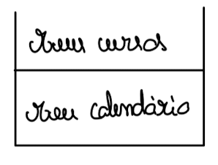
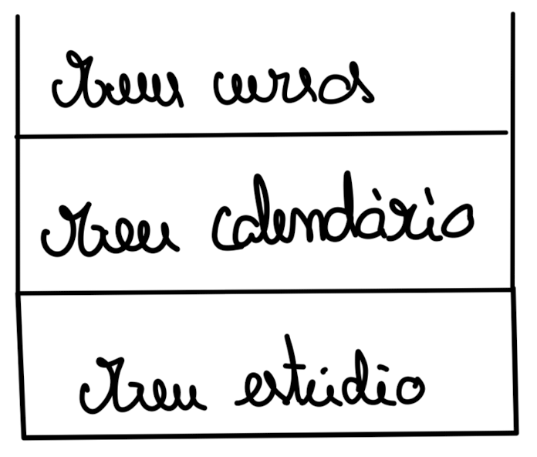
LFP User Evaluation Brainwave Academy
Users:
IHC students and teacher
Overall, the users performed the tasks without problems except for the 2nd teacher's task.
Comments:
"The "Meus Cursos" tab in the teacher session is misleading”
"Change the button to add a video to a course to make it more noticeable"
We also changed the "Curso" dropdown to a single "Todos os Cursos" tab
We removed the "Professores" tab because was unnecessary.

Slide 23
03
Platform Used for the functional prototype Brainwave Academy

Slide 24





Used Platform and Tools Brainwave Academy
Development server
CSS Framework
JSON server and
Local Storage
Open source software
Ready-made components using Tailwind

Slide 25
04
User Evaluation of the functional prototype Brainwave Academy

Slide 26
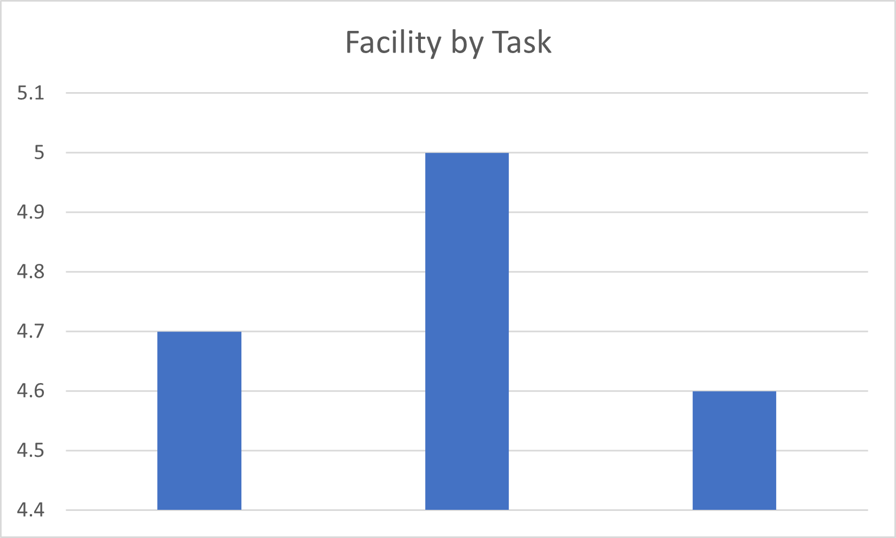
User Evaluation of the functional prototype Brainwave Academy
Student:​
Task 1: Using the filters, find a course up to 100 euros and choose the cheapest one, buying with a credit card. Go to the course and start watching the first video.​
Task 2: Go to your calendar and add a math study assignment.​
​
​
Professor:​
Task 3: Through the notifications icon, respond to a comment from a student.​
Task 4: Create a course called "Matemática A" and add a video in it called "Polinómios".​
10 participants
(0-5)
Task 1
Task 2
Task 3

Slide 27
05
Functional prototype: Demo Brainwave Academy

Slide 28
Changes after User Evaluation of the functional prototype Brainwave Academy
Click "Enter" to send the comment;
When a purchase is finalized, the user is redirected to the page of the purchased course;
Purchase Form validation;
On the calendar page, the placeholder for tasks is now bigger;
Delete button for comments;
The "Buy" button is now bigger;
On the calendar modal, the theme of the event can now be a subject or another of the user's choice
Search bars implemented;
"Unsubscribe course" option added;
"Teacher's Space" page added:
Create/delete/edit courses
View comments

Slide 29
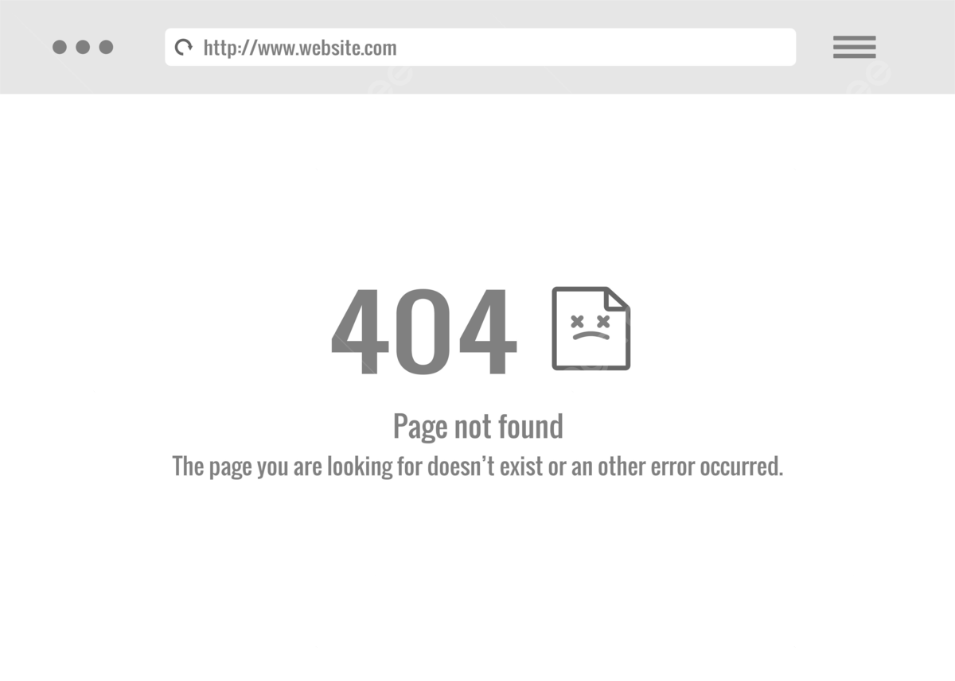
Heuristic Evaluation Brainwave Academy
Few tips – Heuristic: Help and Documentation – Severity: 2 out of 4
Few shortcuts – Heuristic: Efficiency and flexibility of use – Severity: 1 out of 4
Missing “Page Not Found” page – Heuristic: Helping users recognize, diagnose, and recover from errors – Severity: 2 out of 4

Slide 30
06
Future Work Brainwave Academy

Slide 31

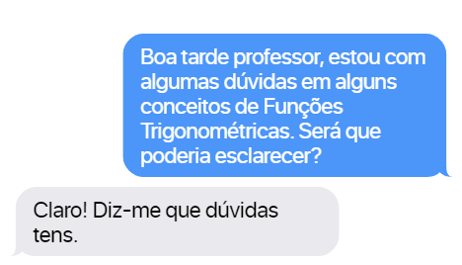
Future Work Brainwave Academy
Build a data base
Add a login/registation page
Private chat with a teacher

